Slide 1
Session 39 : Data storage
using SQLite 3
Module 4.3 : Android

Slide 2
Learning Objectives
At the end of the session successful participants will be able to
Understand Database Visibility
Use SQLITE Command Line
Use SQLITE3 Commands
Use GUI Tools For SQLITE
Use SQLite Administrator

Slide 3
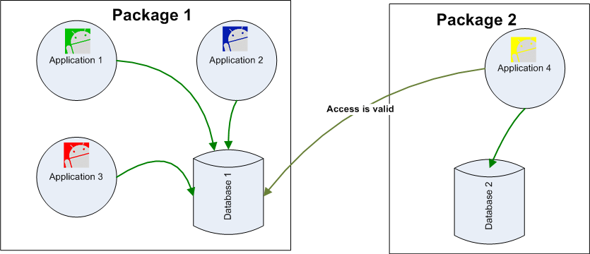
Android Persistency – SQL Database
SQL Database
Database Visibility
Any Application can access an SD stored database. All it’s needed is knowledge of the path where the database file is located. Other (ContentProvider) ways of sharing will be explored later.

Slide 4
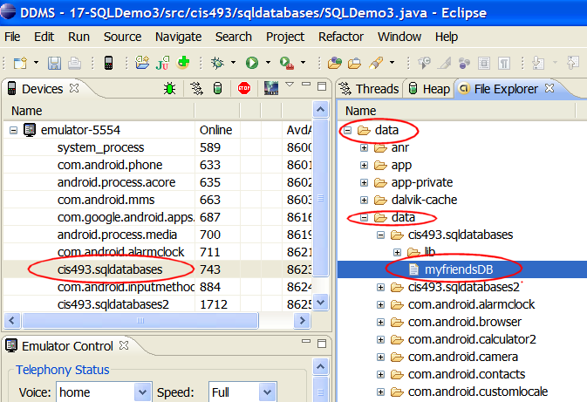
Android Persistency – SQL Database
SQL Database
Database Location
Emulator’s File Explorershowing the placement of the database

Slide 5
Android Persistency – SQL Database
SQL Database
Using SQLITE Command Line
The Android SDK contains a command line interface to SQLITE databases. To open/Create a database use the command
C:> sqlite3 myNewDatabase
You may directly reach the Emulator’s data folder and operate on existing databases.
Assume an emulator is running.
We will use adbshell to tap in the emulator’s internal memory

Slide 6
Android Persistency – SQL Database
SQL Database
Using SQLITE Command Line
Type the following commands in DOS command prompt:
Microsoft Windows XP [Version 5.1.2600](C) Copyright 1985-2001 Microsoft Corp.
E:\Android> adbshell
# sqlite3 /data/data/matos.sql1/databases/myfriendsDB
sqlite3/data/data/matos.sql1/databases/myfriendsDB
SQLiteversion 3.5.9
Enter ".help" for instructions

Slide 7
Android Persistency – SQL Database
SQL Database
Using SQLITE Command Line
Type the following commands in DOS command prompt:
sqlite> .tables
.tables
android_metadatatblAMIGO
sqlite> select * from tblAMIGO;
1|AAAXXX|555
2|BBBXXX|777
3|Maria|999
4|Maria|000
5|Maria|001
sqlite> .exit
#

Slide 8
Android Persistency – SQL Database
SQL Database
Summary SQLITE3 Commands: sqlite3>.help
.bailON|OFF | Stop after hitting an error. Default OFF
.databases | List names and files of attached databases
.dump? TABLE?... | Dump the database in an SQL text format
.echo ON|OFF | Turn command echo on or off
.exit | Exit this program
.explain ON|OFF | Turn out put mode suitable for EXPLAIN on or off.
.header(s) ON|OFF | Turn display of headers on or off
.help | Show this message
.import FILE TABLE | Import data from FILE into TABLE
.indices TABLE | Show names of all indices on TABLE
.load FILE? ENTRY? | Load an extension library

Slide 9
Android Persistency – SQL Database
SQL Database
Summary SQLITE3 Commands: sqlite3>.help
.modeMODE?TABLE? | Set output mode where MODE is one of:
csv | Comma-separated values
column | Left-aligned columns. (See .width)
html | HTML <table> code
insert | SQL insert statements for TABLE
line | One value per line
list | Values delimited by .separator string
tabs | Tab-separated values
tcl | TCL list elements

Slide 10
Android Persistency – SQL Database
SQL Database
Summary SQLITE3 Commands: sqlite3>.help
.nullvalueSTRING | Print STRING in place of NULL values
.outputFILENAME | Send output to FILE NAME
.outputstdout | Send output to the screen
.promptMAINCONTINUE | Replace the standard prompts
.quit | Exit this program
.read FILENAME | Execute SQL in FILENAME
.schema ?TABLE? | Show the CREATE statements
.separator STRING | Change separator used by output mode and .import

Slide 11
Android Persistency – SQL Database
SQL Database
Summary SQLITE3 Commands: sqlite3>.help
.show | Showthecurrentvaluesforvarioussettings
.tables?PATTERN? | ListnamesoftablesmatchingaLIKEpattern
.timeoutMS | TryopeninglockedtablesforMSmilliseconds
.widthNUMNUM... | Setcolumnwidthsfor"column"mode

Slide 12
Android Persistency – SQL Database
SQL Database
Using GUI Tools For SQLITE
In order to move a copy of the database in and out of the Emulator’s storage space and either receive or send the file into/from the local computer’s file system you may use the commands:
adbpull<full_path_to_database> adbpush<full_path_to_database>

Slide 13

Android Persistency – SQL Database
SQL Database
Using GUI Tools For SQLITE
You may also use the Eclipse’s DDMS Perspective to push/pull files in/out the emulator’s file system.
Once the database is in your computer’s disk you may manipulate the database using a ‘user-friendly’ tool such as:
SQLiteManager(Firefox adds-on)
SQLiteAdministrator(http://sqliteadmin.orbmu2k.de)

Slide 14
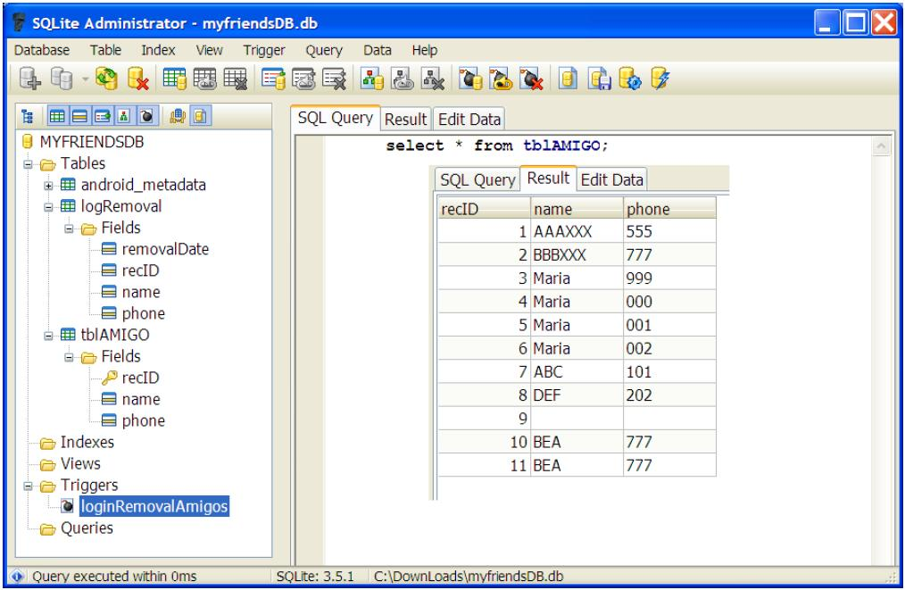
Android Persistency – SQL Database
SQL Database
Using SQLite Administrator

Slide 15
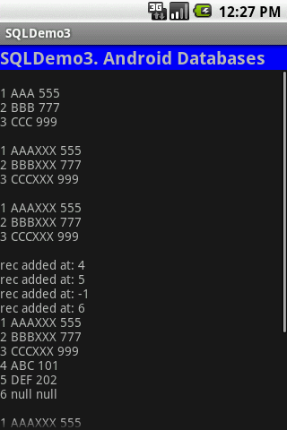
Android Persistency – SQL Database
SQL Database
Example: Complete Listing for Previous Fragments
<?xml version="1.0" encoding="utf-8"?>
<LinearLayoutxmlns:android="http://schemas.android.com/apk/res/android"
android:orientation="vertical"
android:layout_width="fill_parent"
android:layout_height="fill_parent"
>

Slide 16
Android Persistency – SQL Database
SQL Database
Example: Complete Listing for Previous Fragments
<TextView
android:id="@+id/txtCaption"
android:text="SQLDemo3. Android Databases"
android:layout_width="fill_parent"
android:layout_height="wrap_content"
android:background="#ff0000ff"
android:textSize="20px"
android:textStyle="bold"/>

Slide 17
Android Persistency – SQL Database
SQL Database
Example: Complete Listing for Previous Fragments
<ScrollView
android:id="@+id/ScrollView01"
android:layout_width="fill_parent"
android:layout_height="fill_parent">
<TextView
android:id="@+id/txtMsg"
android:text=""
android:layout_width="fill_parent"
android:layout_height="wrap_content" />
</ScrollView>
</LinearLayout>

Slide 18
Android Persistency – SQL Database
SQL Database
Example: Complete Listing for Previous Fragments
//USING ANDROID-SQLITE DATABASES
package cis493.sqldatabases;
import android.app.Activity;
import android.content.ContentValues;
import android.database.Cursor;
import android.database.SQLException;
import android.database.sqlite.SQLiteDatabase;
import android.database.sqlite.SQLiteException;
import android.os.Bundle;
import android.widget.TextView;
import android.widget.Toast;
publicclassSQLDemo3 extendsActivity {

Slide 19
Android Persistency – SQL Database
SQL Database
Example: Complete Listing for Previous Fragments
SQLiteDatabasedb;
TextViewtxtMsg;
@Override
public void onCreate(Bundle savedInstanceState) {
super.onCreate(savedInstanceState);
setContentView(R.layout.main);
txtMsg= (TextView) findViewById(R.id.txtMsg);
try{
openDatabase();//open (create if needed) database
dropTable();//if needed drop table tblAmigos
insertSomeDbData();//create-populate tblAmigos
useRawQuery1(); //fixed SQL with no arguments

Slide 20
Android Persistency – SQL Database
SQL Database
Example: Complete Listing for Previous Fragments
useRawQuery2(); //parameter substitution
useRawQuery3(); //manual string concatenation
useSimpleQuery1();//simple query
useSimpleQuery2();//nontrivial 'simple query'
useCursor1();//retrieve rows from a table
updateDB();//use execSQLto update
useInsertMethod();//use insert method
useUpdateMethod();//use update method
useDeleteMethod();//use delete method
db.close();//make sure to release the DB
Toast.makeText(this,"Alldone!",1).show();}catch(Exception e) {Toast.makeText(this,e.getMessage(),1).show();}}// onCreate

Slide 21
Android Persistency – SQL Database
SQL Database
Example: Complete Listing for Previous Fragments [openDatabase]
private void openDatabase() {
try{
db= SQLiteDatabase.openDatabase(
"data/data/cis493.sqldatabases/myfriendsDB",
//"sdcard/myfriendsDB",
null,
SQLiteDatabase.CREATE_IF_NECESSARY) ;
Toast.makeText(this, "DB was opened!", 1).show();
} catch(SQLiteException e) {
Toast.makeText(this, e.getMessage(), 1).show();
}}//createDatabase

Slide 22
Android Persistency – SQL Database
SQL Database
Example: Complete Listing for Previous Fragments
[insertSomeDbData]
private void insertSomeDbData() {
//create table: tblAmigo
db.beginTransaction();
try{
db.execSQL("create table tblAMIGO("
+ " recIDinteger PRIMARY KEY autoincrement, "
+ " name text, "
+ " phone text ); ");
//commit your changes
db.setTransactionSuccessful();
Toast.makeText(this, "Table was created",1).show();

Slide 23
Android Persistency – SQL Database
SQL Database
Example: Complete Listing for Previous Fragments
[insertSomeDbData]
} catch(SQLExceptione1) {
Toast.makeText(this, e1.getMessage(),1).show();
}
finally{
//finish transaction processing
db.endTransaction();
}
// populate table: tblAmigo
db.beginTransaction();
Try{//insert rows
db.execSQL( "insert into tblAMIGO(name, phone) "
+ " values ('AAA', '555' );");

Slide 24
Android Persistency – SQL Database
SQL Database
Example: Complete Listing for Previous Fragments
[insertSomeDbData]
db.execSQL("insert into tblAMIGO(name, phone) "
+ " values ('BBB', '777' );");
db.execSQL("insert into tblAMIGO(name, phone) "
+ " values ('CCC', '999' );");
//commit your changes
db.setTransactionSuccessful();
Toast.makeText(this, " 3 records were inserted",1).show();
}
catch(SQLiteException e2) {
//report problem
Toast.makeText(this, e2.getMessage(),1).show();
}

Slide 25
Android Persistency – SQL Database
SQL Database
Example: Complete Listing for Previous Fragments
[insertSomeDbData]
finally{
db.endTransaction();
}
}//insertSomeData

Slide 26
Android Persistency – SQL Database
SQL Database
Example: Complete Listing for Previous Fragments
[useRawQuery1]
private void useRawQuery1() {
Try{//hard-coded SQL-select command with no arguments
String mySQL="select count(*) as Total from tblAMIGO“;
Cursor c1 = db.rawQuery(mySQL, null);
intindex = c1.getColumnIndex("Total");
//advance to the next record (first rec. if necessary)
c1.moveToNext();
inttheTotal= c1.getInt(index);
Toast.makeText(this, "Total1: "+ theTotal, 1).show();
} catch(Exception e) {
Toast.makeText(this, e.getMessage(), 1).show();
}}//useRawQuery1

Slide 27
Android Persistency – SQL Database
SQL Database
Example: Complete Listing for Previous Fragments
[useRawQuery2]
privatevoiduseRawQuery2() {
try{
// ? arguments provided for automatic replacement
String mySQL= " select count(*) as Total "
+ " from tblAmigo"
+ " where recID> ? "
+ " and name = ? ";
String[] args= {"1", "BBB"};
Cursor c1 = db.rawQuery(mySQL, args);
intindex = c1.getColumnIndex("Total");
//advance to the next record (first rec. if necessary)
c1.moveToNext();

Slide 28
Android Persistency – SQL Database
SQL Database
Example: Complete Listing for Previous Fragments
[useRawQuery2]
inttheTotal= c1.getInt(index);
Toast.makeText(this, "Total2: "+ theTotal, 1).show();
} catch(Exception e) {
Toast.makeText(this, e.getMessage(), 1).show();
}
}//useRawQuery2

Slide 29
Android Persistency – SQL Database
SQL Database
Example: Complete Listing for Previous Fragments
[useRawQuery3]
privatevoiduseRawQuery3() {
try{
//arguments injected by manual string concatenation
String[] args= {"1", "BBB"};
String mySQL= " select count(*) as Total "
+ " from tblAmigo"
+ " where recID> "+ args[0]
+ " and name = '"+ args[1] + "'";
Cursor c1 = db.rawQuery(mySQL, null);
intindex = c1.getColumnIndex("Total");
//advance to the next record (first rec. if necessary)
c1.moveToNext();

Slide 30
Android Persistency – SQL Database
SQL Database
Example: Complete Listing for Previous Fragments
[useRawQuery3]
inttheTotal= c1.getInt(index);
Toast.makeText(this, "Total3: "+ theTotal, 1).show();
} catch(Exception e) {
Toast.makeText(this, e.getMessage(), 1).show();
}
}//useRawQuery3

Slide 31
Android Persistency – SQL Database
SQL Database
Example: Complete Listing for Previous Fragments
[simpleQuery1]
private void useSimpleQuery1() {
try{
//simple (implicit) query on one table
String [] columns = {"recID", "name", "phone"};
Cursor c1 = db.query(
"tblAMIGO",
columns,
"recID> 2 and length(name) >= 3 and name like 'B%' ",
null, null, null,
"recID");
inttheTotal= c1.getCount();
Toast.makeText(this, "Total4: "+ theTotal, 1).show();

Slide 32
Android Persistency – SQL Database
SQL Database
Example: Complete Listing for Previous Fragments
[simpleQuery1]
} catch(Exception e) {
Toast.makeText(this, e.getMessage(), 1).show();
}
}//useSimpleQuery1

Slide 33
Android Persistency – SQL Database
SQL Database
Example: Complete Listing for Previous Fragments
[simpleQuery2]
private void useSimpleQuery2() {
try{
//nontrivial 'simple query' on one table
String [] selectColumns= {"name", "count(*) as TotalSubGroup"};
String whereCondition= "recID>= ?";
String [] whereConditionArgs= {"1"};
String groupBy= "name";
String having = "count(*) <= 4";
String orderBy= "name";
Cursor c = db.query("tblAMIGO",
selectColumns,

Slide 34
Android Persistency – SQL Database
SQL Database
Example: Complete Listing for Previous Fragments
[simpleQuery2]
whereCondition, whereConditionArgs,
groupBy,
having,
orderBy);
inttheTotal= c.getCount();
Toast.makeText(this, "Total5: "+ theTotal, 1).show();
} catch(Exception e) {
Toast.makeText(this, e.getMessage(), 1).show();
}
}//useSimpleQuery2

Slide 35
Android Persistency – SQL Database
SQL Database
Example: Complete Listing for Previous Fragments
[useCursor1]
privatevoiduseCursor1() {
try{
txtMsg.append("\n");
// obtain a list of <recId, name, phone> from DB
String[] columns = { "recID", "name", "phone"};
Cursor c = db.query("tblAMIGO", columns,
null, null, null, null, "recID");
inttheTotal= c.getCount();
Toast.makeText(this, "Total6: "+ theTotal, 1).show();
intidCol= c.getColumnIndex("recID");
intnameCol= c.getColumnIndex("name");
intphoneCol= c.getColumnIndex("phone");

Slide 36
Android Persistency – SQL Database
SQL Database
Example: Complete Listing for Previous Fragments
[useCursor1]
while(c.moveToNext()) {
columns[0] = Integer.toString((c.getInt(idCol)));
columns[1] = c.getString(nameCol);
columns[2] = c.getString(phoneCol);
txtMsg.append( columns[0] + " "+ columns[1] + " "
+ columns[2] + "\n");
}
} catch(Exception e) {
Toast.makeText(this, e.getMessage(), 1).show();
}
}//useCursor1

Slide 37
Android Persistency – SQL Database
SQL Database
Example: Complete Listing for Previous Fragments
[updateDB]
privatevoidupdateDB(){
//action query using execSQL
String theValue;
try{
theValue= "222";
db.execSQL(" update tblAMIGO"
+ " set name = (name || 'XXX') "
+ " where phone >= '"+ theValue+ "' ");
useCursor1();
} catch(Exception e) {
Toast.makeText(this,"updateDB"+ e.getMessage(), 1).show();
}useCursor1();}

Slide 38
Android Persistency – SQL Database
SQL Database
Example: Complete Listing for Previous Fragments
[dropTable]
private void dropTable(){
//(clean start) action query to drop table
try{
db.execSQL( " drop table tblAmigo; ");
Toast.makeText(this, "Table dropped", 1).show();
} catch(Exception e) {
Toast.makeText(this,
"dropTable()\n"+ e.getMessage(), 1).show();
}
}// dropTable

Slide 39
Android Persistency – SQL Database
SQL Database
Example: Complete Listing for Previous Fragments
[useInsertMethod]
public void useInsertMethod() {
ContentValuesinitialValues= newContentValues();
initialValues.put("name", "ABC");
initialValues.put("phone", "101");
introwPosition= (int) db.insert("tblAMIGO", null, initialValues);
txtMsg.append("\nrecadded at: "+ rowPosition);
initialValues.put("name", "DEF");
initialValues.put("phone", "202");
rowPosition= (int) db.insert("tblAMIGO", null, initialValues);
txtMsg.append("\nrecadded at: "+ rowPosition);

Slide 40
Android Persistency – SQL Database
SQL Database
Example: Complete Listing for Previous Fragments
[useInsertMethod]
initialValues.clear();
rowPosition= (int) db.insert("tblAMIGO", null, initialValues);
txtMsg.append("\nrecadded at: "+ rowPosition);
rowPosition= (int) db.insert("tblAMIGO", "name", initialValues);
txtMsg.append("\nrecadded at: "+ rowPosition);
useCursor1();
}// useInsertMethod

Slide 41
Android Persistency – SQL Database
SQL Database
Example: Complete Listing for Previous Fragments
[useUpdateMethod]
private void useUpdateMethod() {
//using the update method to change name of selected friend
String [] whereArgs= {"2", "7"};
ContentValuesupdValues= newContentValues();
updValues.put("name", "Maria");
intrecAffected=db.update("tblAMIGO",
updValues,
"recID> ? and recID< ?",
whereArgs);
Toast.makeText(this, "Total7: "+ recAffected, 1).show();
useCursor1();
}

Slide 42
Android Persistency – SQL Database
SQL Database
Example: Complete Listing for Previous Fragments
[useDeleteMethod]
private void useDeleteMethod() {
//using the delete method to remove a group of friends
//whose id# is between 2 and 7
String [] whereArgs= {"2", "7"};
intrecAffected= db.delete("tblAMIGO",
"recID> ? and recID< ?",
whereArgs);
Toast.makeText(this, "Total8: "+ recAffected, 1).show();
useCursor1();
}// useDeleteMethod
}//class

Slide 43
Android Persistency – SQL Database
SQL Database
Example: Complete Listing for Previous Fragments
[useDeleteMethod]
private void useDeleteMethod() {
//using the delete method to remove a group of friends
//whose id# is between 2 and 7
String [] whereArgs= {"2", "7"};
intrecAffected= db.delete("tblAMIGO",
"recID> ? and recID< ?",
whereArgs);
Toast.makeText(this, "Total8: "+ recAffected, 1).show();
useCursor1();
}// useDeleteMethod
}//class

Slide 44
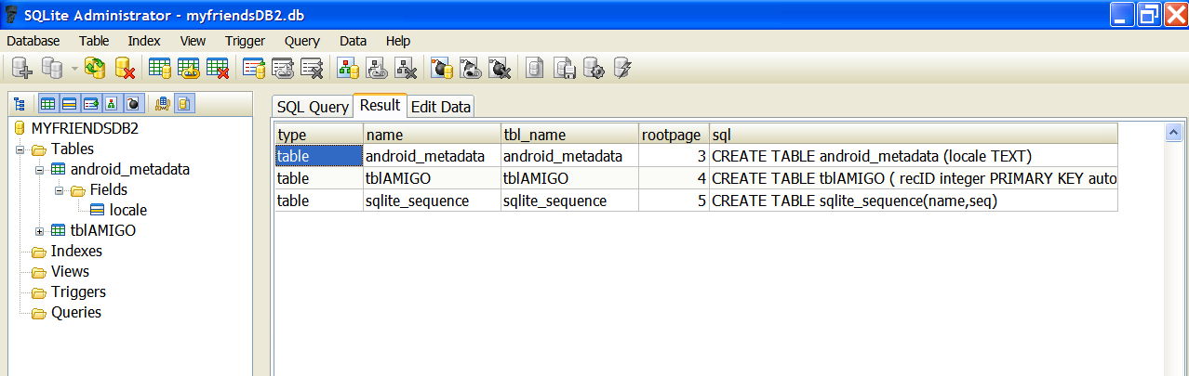
Android Persistency – SQL Database
Appendix – 1: Database Dictionary - SQLITE Master Table
You may query the SQLITE master table (named: sqlite_master) looking for a table, index, or other database object.
Example:
select * from sqlite_master;

Slide 45
Android Persistency – SQL Database
Appendix – 1: Database Dictionary - SQLITE Master Table
In Java code you may phrase the test for existence of a database object using something similar to the following fragment
Public boolean tableExists(SQLiteDatabasedb, String tableName)
{
//true if table exists, false otherwise
String mySql= " SELECT name FROM sqlite_master"
+ " WHERE type='table' "
+ " AND name='"+ tableName+ "'";
intresultSize= db.rawQuery(mySql, null).getCount();
if(resultSize==0) {
returntrue;
} else
returnfalse;
}

Slide 46
Android Persistency – SQL Database
Appendix – 2: Convenient Database Command
In Java code you may phrase the request for “CREATE or REPLACE” a table using the following safe construct:
db.execSQL("DROP TABLE IF EXISTS tableXYZ");

